Slide 1
Identifier Keywords Datatypes
Presented By : Vaishnavi Kulthe

Slide 2
Keyword :
Java has a set of keywords that are predefined words that cannot be used as variables, methods, classes, or any other identifiers.
Thus programming language doesn’t allow these keywords to be used by the programmer as identifiers or variable names etc. Despite that, if we use these keywords it will result in a compiler error.
Java has a total of 51 keywords that have predefined meaning and are reserved for use by Java. Out of these 51 keywords, 49 keywords are currently used while the remaining 2 are no more used.
The true false and null − True, false and null represents certain values in Java, they are used as literals. They are not considered as keywords.
Still, you cannot use them as identifiers in Java if you try to do so, a compile time error will be generated.
Reserved words − Among the list of key words list mentioned above the key words goto and const are currently not in use. They are reserved words (for the future use).

Slide 3
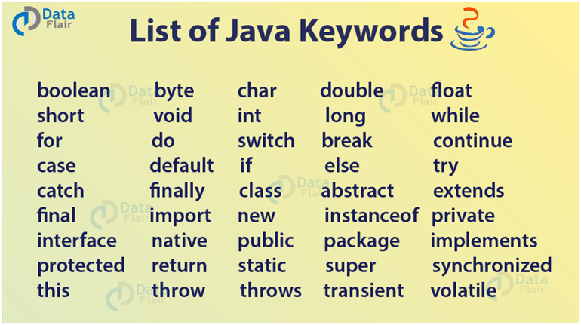

Slide 4
Rules of Keyword :
You cannot use keywords like int ,float as an identifier. EX : int int=10;
you cannot also use true, false, null as identifiers, It is because they are literals.
// EX : int true = 20;
A programmer can not change the meaning of the keyword.
Keywords are always written in lower case.
Separate keywords with either blanks or commas.

Slide 5
IDENTIFIER :
In programming languages, identifiers are used for identification purposes.
The name given to the component of java by the Programmer is known as Identifier .
Examples :
Class
Methods
Variables
Interface
Enum ,etc.
public class Demo //Class Name
{
public static void main(String args[]) //Method name and args: variable name
{
System.out.println("vaishnavi");
}
}

Slide 6
Note : A programmer should follow the rules and conventions for an identifier.
Identifier should never start with the number. //EX : 123Vaish
Identifier should not have especial character except _ and $. //EX :Vaish@
Character space is not allowed in identifier. //EX : int v a ish=10;
We can not use keyword as an identifier. //Ex : int true=0;
Identifier names are unique. // EX : int a=10;
//Ex : int a1=10;
Identifiers can consist of only letters, digits, or underscore. //EX int a1=10;
Examples of valid identifier :MyVariable, MYNAME, X, I, x1,_myname, $myname, sum_of_no, vaish123 ,etc.

Slide 7
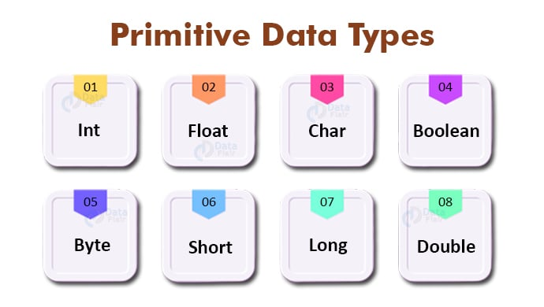
DATATYPES :
Data types in Java are of different sizes and values that can be stored in the variable that is made as per convenience and circumstances to cover up all test cases.
Java has two categories in which data types are segregated :
Primitive Data Type: such as boolean, char, int, short, byte, long, float, and double
Non-Primitive Data Type or Object Data type: such as String, Array, etc.

Slide 8
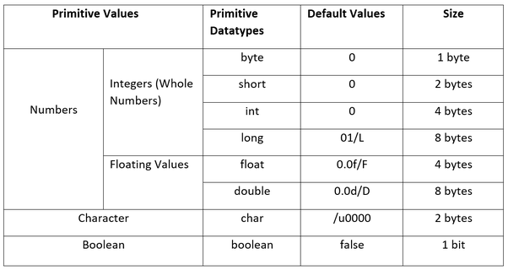
Primitive Data Type:
The datatype which is used to create a variable to store a primitive values such as Numbers, Character, Boolean is known as Primitive Datatype.
All Primitive Datatypes are keywords in java.

Slide 9
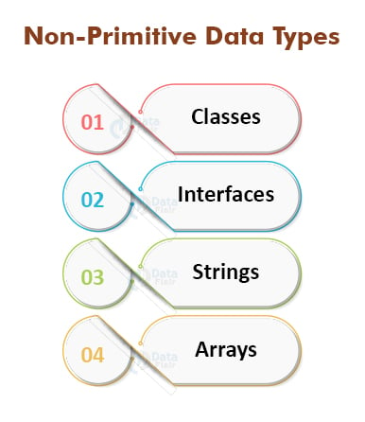
2.Non-Primitive Data Type or Object Data type:
The datatype which is used to create a Non-Primitive variable to store a the reference values such as Class, Interface, Array,String is called Non-Primitive Datatype.
It is also called as Reference type because they refer to object.

Slide 10
THANK YOU !!

